Slide 1
MACHINE LEARNING BASICS WITH PYTHON: USE CASE: CUSTOMER TELECOM CHURN PREDICTION
PRESENTER: FATIMAH TASALLAH RUFAI
CO-PRESENTER: AMINAH MARDIYYAH RUFAI

Slide 2
ABOUT US - Fatimah Tasallah Rufai
I am a machine learning beginner and a 3D Africa campus ambassador
I am an aspiring Pysiotherapist and an AI enthusiast
My Goal is use AI to facilitate therapeutic and rehabilitation process as a Physiotherapist
And also insipire females into this very exciting and interesting field

Slide 3
About us - Aminah Mardiyyah Rufai
I hold a Bachelor's degree in Chemical engineering and a Master's degree in Biomedical engineering.
I code in Python and i'm a Machine learning/Artificial Intelligence enthusiast.
I currently work at Brainiacs STEM and Robotics.
I am also an ambassador and an assistant organizer for Open Data Science Conference, Lagos Nigeria.

Slide 4
INTRODUCTION TO MACHINE LEARNING

Slide 5
WHAT IS MACHINE LEARNING??
Train
Learn
Predict

Slide 6
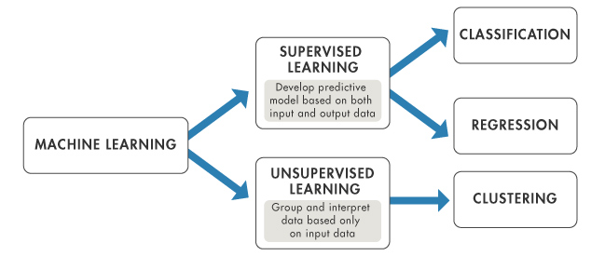
WHAT IS MACHINE LEARNING??

Slide 7
TYPES OF SUPERVISED LEARNING
REGRESSION ALGOLRITMS
Simple Linear Regression
Multiple Linear Regression
Polynomial Regression
Random Forest Regressor
Support Vector Regressor(SVR).....etc
CLASSIFICATION ALGORITHMS
Logistic Regression
Random Forest Classifier
K Nearest Neighbor(KNN) Classifier
Support Vector Machine(SVM) Classifier
Decision Tree Classifier....etc.

Slide 8
TYPES OF UNSUPERVISED LEARNINGT
CLUSTERING ALGOLRITMS
Hierarchical clustering
K-means clustering
K-NN (k nearest neighbors)
ASSOCIATION
Apriori
Eclat

Slide 9
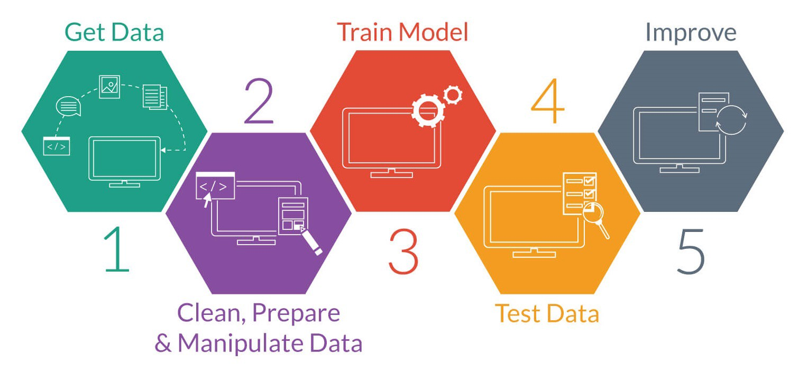
A Basic Machine Learning Workflow

Slide 10

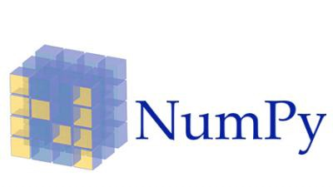
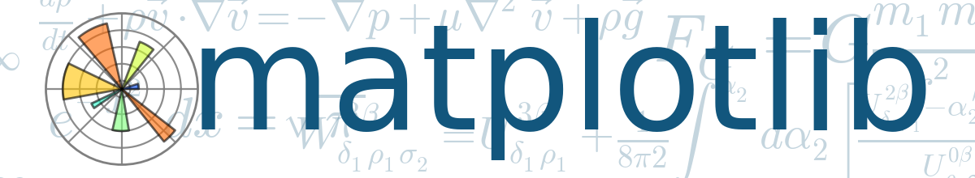


BASIC MACHINE LEARNING LIBRARIES
PANDAS(Panel Data(S) - for data preprocessing.
NUMPY(Numerical Python) - for linear algebra
MATPLOTLIB - for data visualization
SEABORN - also for visualization
SCIKITLEARN(SKLearn) - for working with classical ML algortihms
Notes:
NUmpy is a data handling library

Slide 11





OTHER COMMON LIBRARIES ARE

Slide 12
HANDS-ON-PRACTICE WITH JUPYTER NOTEBOOK

Slide 13
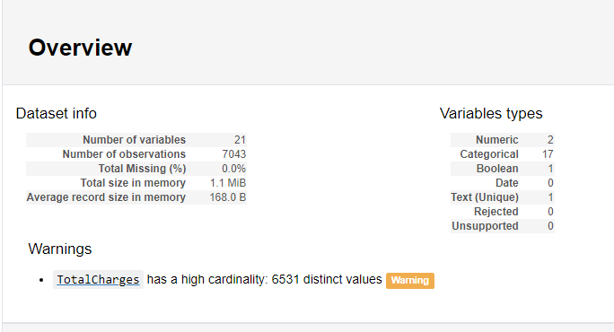
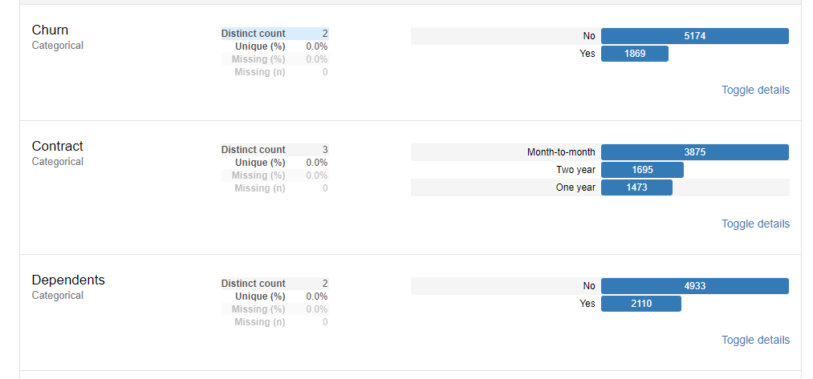
A PEEK INTO THE DATASET

Slide 14
MACHINE LEARNING ALGORTIHMS USED
Catboost
Logistic regression
KNearest Neighbor(KNN)
Naive Bayes

Slide 15
CONCLUSION
Catboost gave an accuracy of 0.8454
Logistic Regression gave an accuracy of 0.779
KNN gave an accuracy of 0.760
Naive Bayes gave an accuracy of 0.746

Slide 16


